Slide 1
BCA CAPSTONE PROJECT (Review I) Medication Reminder App
Submitted to the Presidency University, Bengaluru in partial fulfillment for the award of the degree of Bachelor of Computer Applications(BCA)
Project Team No : 78
Under the supervision of
Mr.Sakthi S Assistant Professor, School Of Computer Science And Engineering
Name | Roll Number
Pinjari Afsheen Misba | 20231BCD0025
Pinjari Ummi Salma | 20231BCD0026
Yashwini R | 20231BCD0037
Gifty Mary Charly | 20231BCD0046

Slide 2
Content
Problem Statement
Literature Survey
Model Design
Tools and Technologies to be used
Github Link
Timeline of the Project
Conclusion
References

Slide 3
Problem Statement
Many patients forget to take their medications on time, leading to serious health risks.
Existing solutions lack caregiver monitoring and smart reminders.
A reliable, AI-powered mobile app can bridge this gap by providing personalized reminders.
Objective: Develop a mobile app that provides reminders, tracks doses, and allows remote monitoring.
Proposed Solution: A smart app with alerts, tracking, and caregiver integration.
Expected Outcome: Improved adherence, reduced health risks, and better patient health management.

Slide 4
Literature Review
Paper Name | Author(s) | Year | Methodology | Advantages | Disadvantages
GoMed: Daily Medicine Reminder Application | Afshaan Sarguroh, Munaf Shaikh, Kashif Khan, Dr. Zainab Mirza | 2021 | Android app with features like Medicine Reminder, Restocking Alerts, Nearby Hospital Search, BMI Calculator, and Notes. | User-friendly GUI, easy navigation, multiple health-related features. | Limited to Android devices; lacks online appointment booking.
Med-X, Medicine Reminder App | Prafful Naikode, Poojal Pithwa, Lakshita Landge | 2021 | Android app using alarm and notification modules; Google authentication for reminders; MongoDB for prescription storage. | Allows multiple alarms, stores prescriptions, and targets senior citizens. | Limited to Android devices; lacks integration with healthcare providers.

Slide 5
Literature Review (Cont)
Paper Name | Author(s) | Year | Methodology | Advantages | Disadvantages
IOT-Based Medicine Reminder and Monitoring System for Safe Health | Khushboo Malvi, Kruti Bhardwaj, Prajwal Kokate, Dolly Rahangdale | 2022 | Hardware-based system using IoT, smart medicine box with sensors, alarms, and remote monitoring. | Helps elderly and illiterate users by automating reminders, uses hardware for accuracy. | Requires caretaker setup; limited to hardware, not app-based.
IOT-Based Real Time Medicine Reminder and Tracking System | Sangameshwar Kawdi, Preeti, Namratha, Vijay Laxmi | 2024 | Device using Node MCU microcontroller, LEDs, buzzer, vibrator for multi-modal reminders. | Real-time alerts, customizable reminders, and user-friendly for all ages. | Needs a caretaker to program; depends on device compatibility.

Slide 6
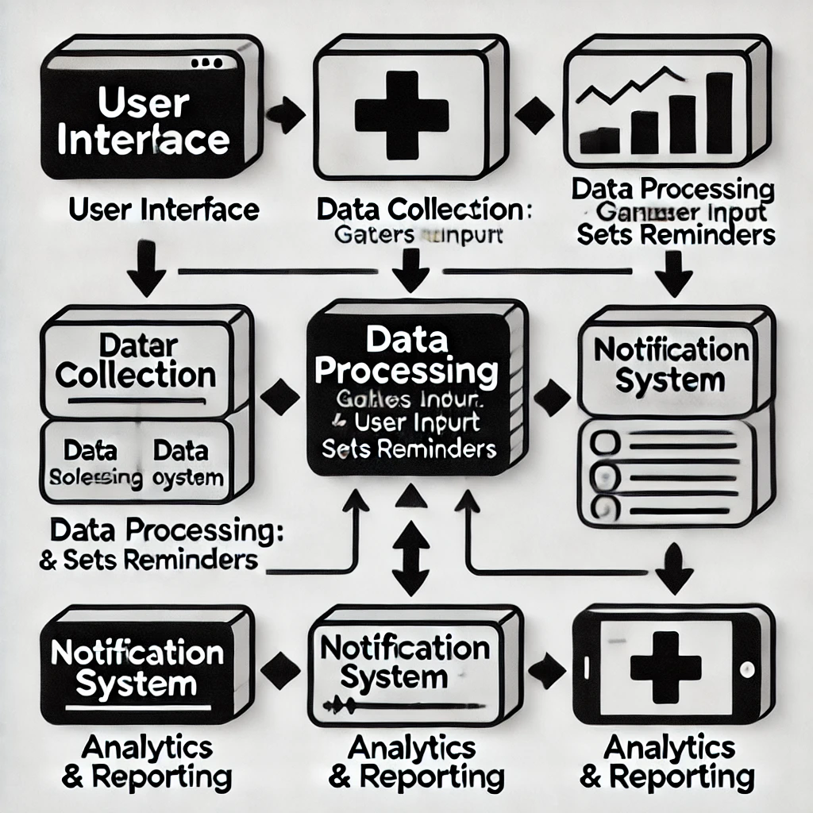
Module Design

Slide 7
Module Design(Cont)
User Interface (UI):
This is the entry point for users.
Users interact with the app to input their medication details — such as names, dosages, and schedules.
Data Collection Module:
Gathers all user inputs, including medication names, times, and frequency.
Ensures all data is properly stored for further processing.
Data Processing Module:
Takes the collected data and processes it.
Sets reminders by converting user input into actionable notifications (like "Take Medicine A at 8 AM").
This module ensures the timing and frequency rules are accurately followed.

Slide 8
Module Design(Cont)
Notification System:
Sends timely alerts or reminders to users about their medication schedule.
Can support push notifications, sound alarms, or messages.
Analytics & Reporting:
Tracks user behavior — whether medications were taken on time or missed.
Provides reports for users or caregivers, helping monitor adherence to prescriptions.

Slide 9
Module Design(Cont)
Purpose of dividing the project into modules
Simplifies Development
Improves Debugging & Testing
Enhances Scalability
Promotes Team Collaboration
Increases Reusability
Better Maintenance
Modular Breakdown
Module 1: User Registration & Profile Management
Module 2: Reminder & Notification System
Module 3: Adherence Tracking & Reporting
Module 4: Caregiver & Doctor Integration

Slide 10
Module Design(Cont)
Module 1: User Registration & Profile Management
Purpose:
This module handles user onboarding, ensuring each user has a personalized experience.
Key Features:
Sign-up/Login: Users can create accounts using email, phone numbers, or social media.
Profile Setup: Users input critical information like age, gender, medical history, and medication needs.
Data Security: Implements secure password storage and data protection practices.

Slide 11
Module Design(Cont)
Module 2: Reminder & Notification System
Purpose:
This module schedules medication reminders and sends alerts to users.
Key Features:
Smart Reminders: Timely push notifications, SMS, or email alerts for medication intake.
Customization: Users can set reminder frequencies — daily, weekly, or custom intervals.
Snooze/Reschedule Options: Allows flexibility if users miss a reminder.

Slide 12
Module Design(Cont)
Module 3: Adherence Tracking & Reporting
Purpose:
To monitor how consistently users follow their medication schedules and generate useful insights.
Key Features:
Logging System: Users confirm medication intake through the app.
Progress Reports: Visual dashboards showing adherence percentages.
Export Data: Generates PDF or CSV reports for personal use or medical reviews.

Slide 13
Module Design(Cont)
Module 4: Caregiver & Doctor Integration
Purpose:
Facilitates collaboration between users, caregivers, and healthcare providers.
Key Features:
Caregiver Access: Enables family members to receive notifications if a user misses a dose.
Doctor Dashboard: Secure portal for doctors to view adherence data and adjust prescriptions.

Slide 14
Tools And Technologies To Be Used
Development Tools: Visual Studio Code, Android Studio
Programming Languages: JavaScript (React Native), Python (Flask/Django)
Frameworks/Libraries: React Native, Flask/Django, Firebase Cloud Messaging (FCM)
Database: MongoDB
Version Control: Git, GitHub
Additional Tools: APIs for medication details, cloud services for storage

Slide 15
Github Link
https://github.com/Gift20032013/medicationreminderapp/upload/main

Slide 16
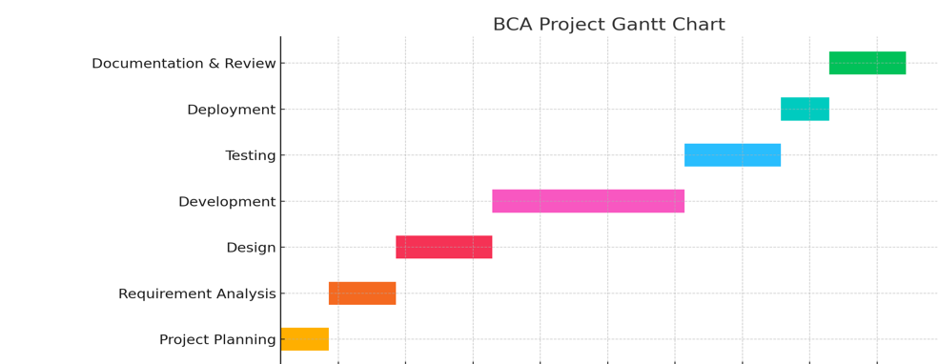
Timeline of the Project (Gantt Chart)
10-Feb-2025
25-Mar -2025
25-Mar to 22-Apr-2025
28-Feb-2025
5-May-2025
25-Mar-2025
22-Apr-2025

Slide 17
Conclusion
This project aims to enhance medication adherence with a smart reminder system.
AI and real-time monitoring set it apart from existing solutions.
The use of modern technologies ensures scalability and efficiency

Slide 18
References
Name | Author Name | Year | About | Link
IOT-Based Real Time Medicine Reminder and Tracking System | Sangameshwar Kawdi, Preeti, Namratha, Vijay Laxmi | 2024 | Innovative solution to address medication non-adherence using IOT, multi-modal reminders, and customizable features. | https://www.irjet.net/archives/V11/i2/IRJET-V11I2117.pdf
GoMed: Daily Medicine Reminder Application | Afshaan Sarguroh, Munaf Shaikh, Kashif Khan, Dr. Zainab Mirza | 2021 | Android-based application with features like Medicine Reminder, Medicine Restocking Alert, BMI Calculator, and more to support medical adherence and improve health. | https://ijarcce.com/wp-content/uploads/2021/05/IJARCCE.2021.10441.pdf

Slide 19
References (Cont)
Name | Author Name | Year | About | Link
IOT-Based Medicine Reminder and Monitoring System for Safe Health | Khushboo Malvi, Kruti Bhardwaj, Prajwal Kokate, Dolly Rahangdale | 2022 | Smart healthcare system built on the IOT with a smart medication box, connected sensors, and servers for continuous health monitoring. | https://www.irjet.net/archives/V9/i12/IRJET-V9I12212.pdf
Med-X, Medicine Reminder App | Prafful Naikode, Poojal Pithwa, Lakshita Landge | 2021 | Android software that helps those who are forgetful or busy remember to take daily meds with customized profiles, auto tracking, and report generation. | https://ijrpr.com/uploads/V2ISSUE11/IJRPR1903.pdf

Slide 20


